Slide 1
Scaling Nagios At A
Giant Insurance Company
Daniel Wittenberg
dwittenberg2008@gmail.com
https://github.com/dwittenberg2008/nagios

Slide 2
Personal Background
Certified for HP-UX in mid 90's, then RHCE in '99, and AIX in early 2000's.
Worked on lots of different technologies and solutions including HA, SAN/iSCSI, Forensics/Security, Backups/Disaster Recovery, Performance Tuning, Capacity Planning, Monitoring/Trending, Networking/Protocol Analysis, Virtualization and Cloud Computing.
Consulted and worked in many industries include insurance, banking, accounting, construction, embedded hardware design, printing/publishing early education, higher education, and ISP/hosting providers.

Slide 3
Topics
Hardware
Operating System
Nagios Core
Plugins
Other Add-ons
Event Brokers
Other Software
Performance Monitoring
General

Slide 4
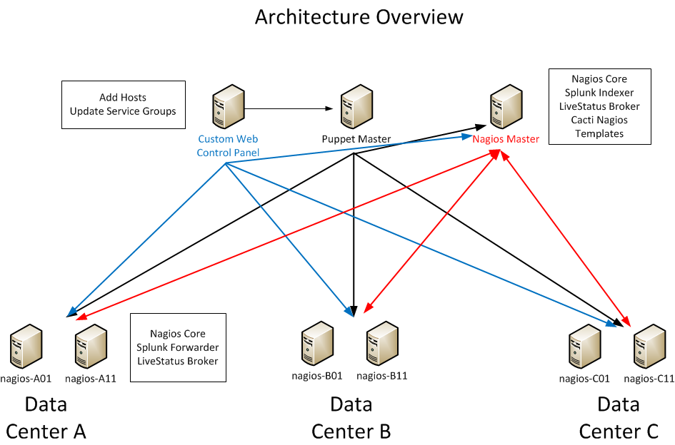
Overview

Slide 5

Hardware
Hardware vs VMware
  High forking rate not good fit for VMware
CPU Requirements
  Quantity vs Quality
Memory
  Typically memory efficient, but have enough for ramdisk(s)
  Affected by your plugins if using active checks
Disk I/O
  Faster the better!

Slide 6
VMware Performance Comparison
Isolated VMWare ESX 4
Procs | Memory | Hosts | Avg Svc Lat | Avg CPU Util | Avg CPU Load | # Act Checks | # Pass Checks
4 | 8 GB | 1000 | 182 | 65 | 5 | 12084 | 6042
8 | 8 GB | 1000 | 162 | 47 | 4 | 12084 | 6042
8 | 8 GB | 600 | 87 | 60 | 8 | 7272 | 3636
Physical Dell PowerEdge R710 (new)
Procs | Memory | Hosts | Avg Svc Lat | Avg CPU Util | Avg CPU Load | # Act Checks | # Pass Checks
4 | 16 GB | 1000 | 0.19 | 10 | 1.25 | 12084 | 6042
8 | 8 GB | 1000 | 0.38 | 25 | 1.15 | 12084 | 6042
Physical HP Proliant DL380 G4 (~ 8 years old)
Procs | Memory | Hosts | Avg Svc Lat | Avg CPU Util | Avg CPU Load | # Act Checks | # Pass Checks
4 | 4 GB | 800 | 0.29 | 32 | 1.95 | 9684 | 4842
8 | 4 GB | 1000 | 0.47 | 37 | 4.43 | 12084 | 6042

Slide 7
Operating System
CentOS / RHEL 5.6
Strip down the running services
Create ramdisks in Nagios RC script
- first one for status.dat, checkresults, temp_file
- second one for pnp processing directory, moved there by nagios perf command
- nagios.rc on github for full rc script
ramdisk=`mount |grep "/var/nagios/ramcache"`
if [ "$ramdisk"X == "X" ]; then
mkdir -p -m 755 /var/nagios/ramcache
mount -t tmpfs -o size=128m tmpfs /var/nagios/ramcache
mkdir -p -m 755 /var/nagios/ramcache/checkresults
chown -R nagios:nagios /var/nagios/ramcache
fi

Slide 8
Operating System
Make sure no ulimit restrictions
ulimit -a
Renice daemons and services
daemon -15 --user=$user $exec -d $config
perfdata_file_run_cmd =/bin/nice -n 20 /usr/libexec/pnp4nagios/process_perfdata.pl
puppet runs also re-niced (/etc/sysconfig/puppet – NICELEVEL=19)

Slide 9
Nagios Core
Currently using Nagios 3.2.3
  Empty hostgroups patch
  Non-existent device patch (causes sigfault w/pipe)
Large Scale Suggestions Doc
  Pre-caching objects
  Re-write RC script to optimize restart time
  Don't allow restart/stop if config broken
  Limit use of macros (resources.cfg)

Slide 10
Nagios Core
Remove use of CGI's
  Using Livestatus/Multisite/livestatus-slave
Limit use of backups (crazy huh?)
Keep logging level low in all core and plugins/brokers
Keep comments limited, delete if X # or Y days old
status_update_interval=20 (default is 10)
(how often to update the status.dat in seconds)
enable_environment_macros=0 (default is 1)
(pass macros as ENV variables)

Slide 11
Plugins
check_nrpe
check_logfiles
check_hpasm / check_dell_sensors / check_dell_omreport
check_oracle_health – check_mysql_health
check_ps.sh (re-written for perf data, correct calculations)
nagios_auto_service
Return perf data whenever possible
Many other custom and one-up plugins

Slide 12
Other Add-ons
NRPE
  Patched to allow large buffer size
NSCA – (NRDP future ?)
  max_packet_age=60, forward and back time patch
  Run from xinetd to allow larger/faster connections
  MUST use instances = UNLIMITED
  Recommend per_source = UNLIMITED
NSClient++
  Many updates for buffering, data truncation, queueing
PNP4Nagios
  0.6 branch, since php53 RPM's available

Slide 13
Event Brokers
DNX
Mod-Gearman (under evaluation)
MK Livestatus
Performance Data Splunker (custom)
Log separator (reduces grepping for messages) (custom)

Slide 14
Other Software
Puppet
  Manage entire server
Splunk
  Log files, performance data
Graylog2 ? (not implemented yet)
Cacti
  Nagiostats template, updated to use livestatus instead of CGI
Custom Control Panel
  Build host groups based on templates, auto-config based on host info
ConSol Labs
  check_logfiles, check_hpasm, mod_gearman, check_mysql_health, check_oracle_health

Slide 15
Performance Monitoring
How to watch your system to determine bottlenecks
vmstat
iostat
top
iptraf
sar
strace
esxtop (if have to use VM)

Slide 16
General Configs
Host config files are standalone configurations that tell everything about a host.
Hosts are tied to a hostgroup
Hostgroups are tied to a servicegroup
Services are tied to a servicegroup
host.cfg → hostgroups → servicegroups ← services
This allows for easy drop-in and removal of hosts, but also requires at least 1 host be assigned to a management server
Limitations – harder to make per-server per-service customizations
Hosts are built/assigned from control panel (round-robin distribution)
Parents built automatically from topology database, updated nightly, ESX hourly
Parent's only ping once a day unless there are problems, uses fping
Some alerts do trigger eventhandlers – auto-fix as much as possible

Slide 17
General Configs
Types of things being monitored:
cpu load, cpu stats (idle/wait/user/system), disk space, log files/Event Log, hardware, processes, swap, memory usage, service ports, NTP drift, cron job completion, UPS
Nagios configtest, livestatus connectivity
PNP4Nagios directory size (keeping up on processing)
Performance (cpu/memory) usage on certain processes
Puppet update time to make sure doesn't get behind
DB Response times (oracle/mysql/postgresql)
Apache Stats
Custom app status (user accounts, response times, loads, etc.)
Various SNMP/WMI values (most network related stats)

Slide 18
Links – where to find this stuff
My Stuff – https://github.com/dwittenberg2008/nagios
MK Livestatus - http://mathias-kettner.de/checkmk_livestatus.html
LivestatusSlave - http://nagios.larsmichelsen.com/livestatusslave/
PNP4Nagios - http://docs.pnp4nagios.org/pnp-0.6/start
ConSol Labs - http://labs.consol.de/
Puppet - http://puppetlabs.com/
DNX - http://dnx.sourceforge.net/
Cacti Template (Base) - http://forums.cacti.net/about33806.html

Slide 19
Questions ?
Suggestions ?

